Slide 1

Nations’ Response to Covid-19:
A Critical Look
By Keshav Narasimhan
Upper St. Clair High School

Slide 2

Covid-19+Why I chose this Project

Slide 3
Problem and Hypotheses

Slide 4
Data Analyses Approach

Slide 5
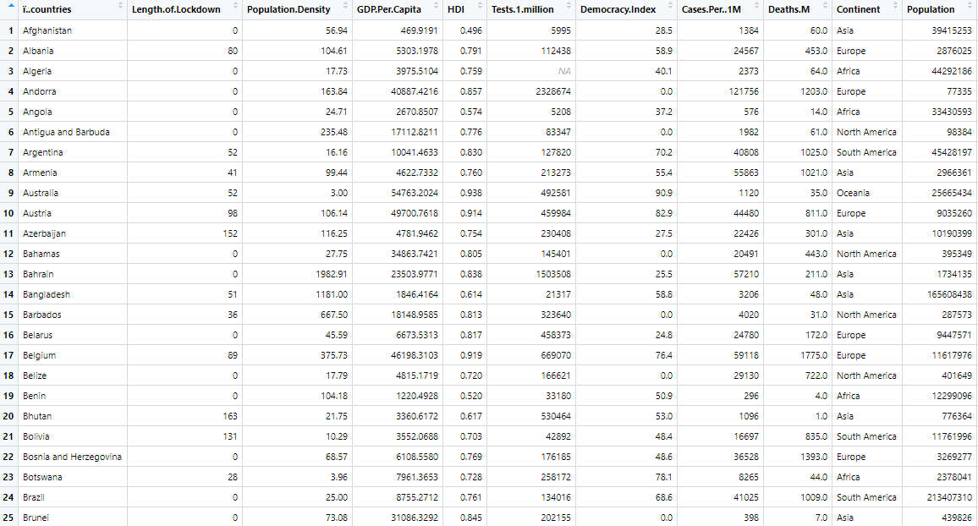
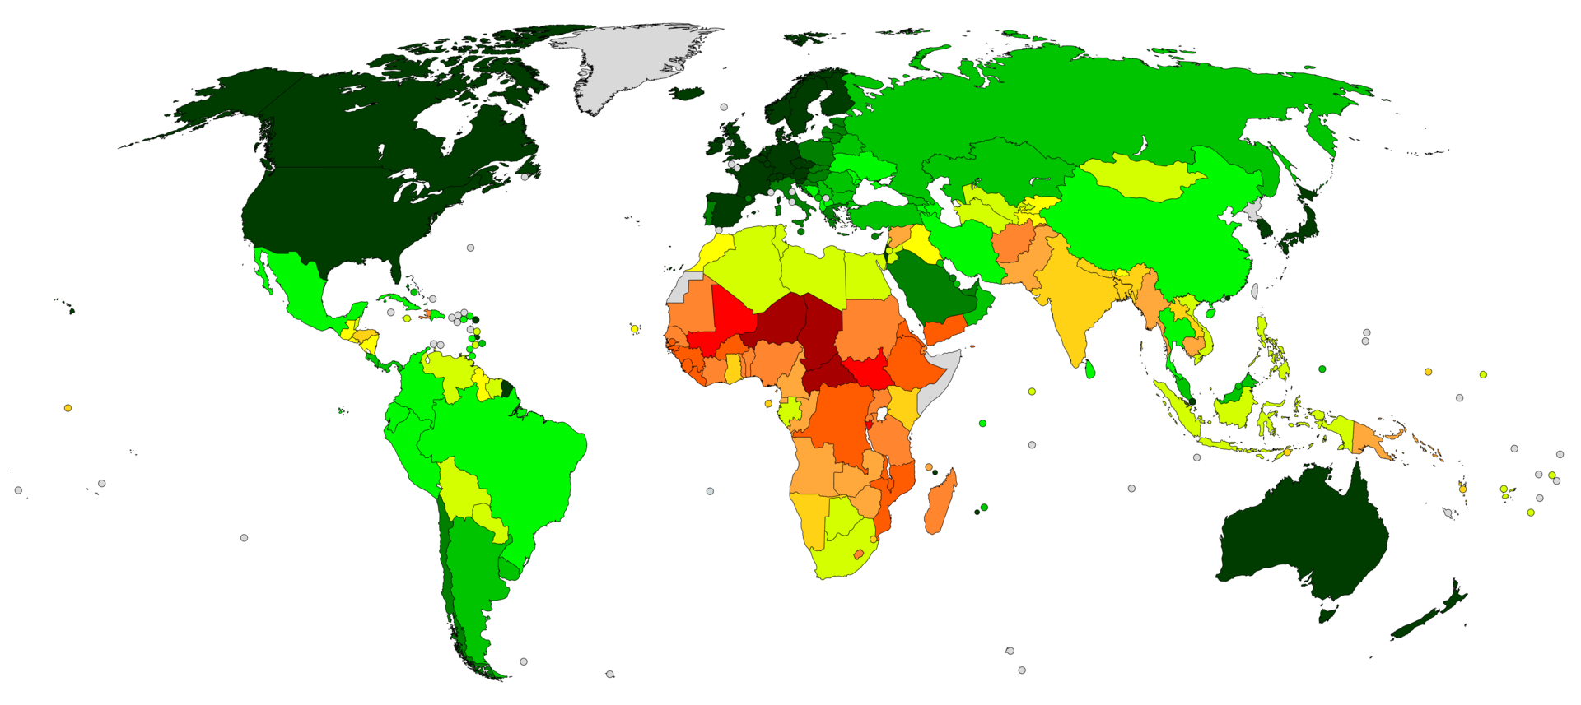
The Data

Slide 6
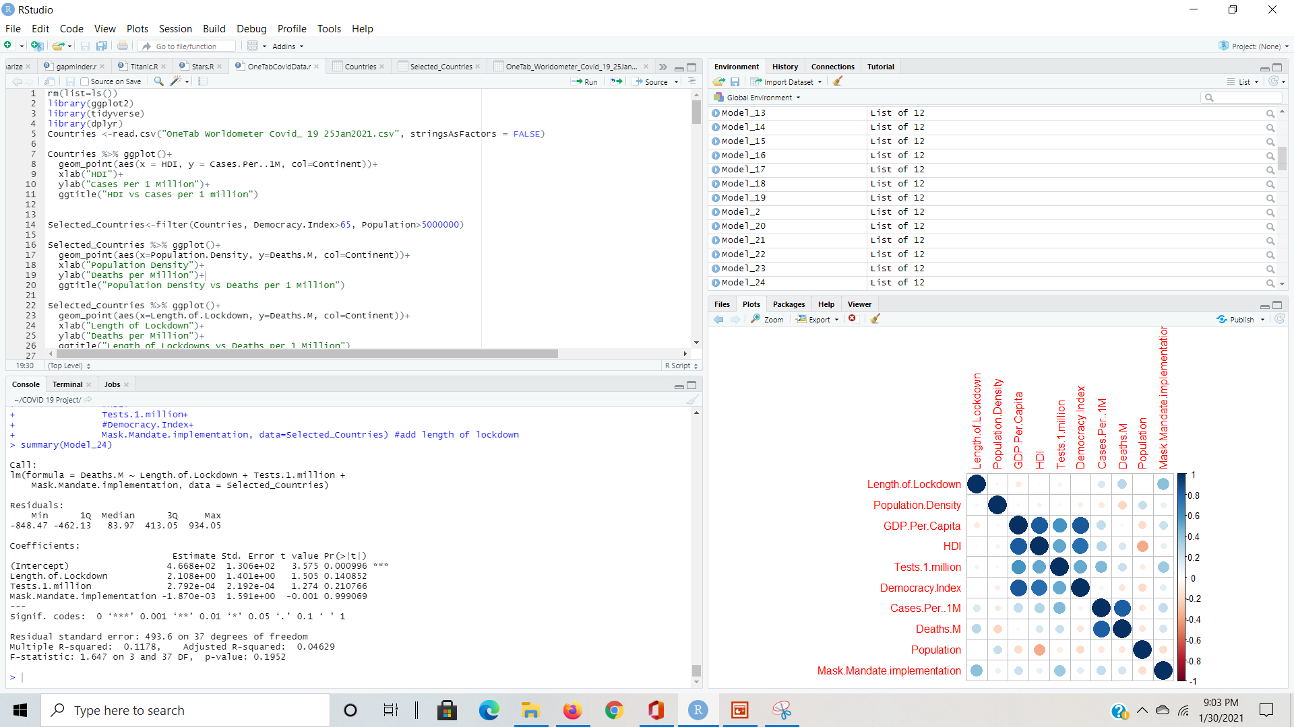
Statistical Programs
Microsoft Excel
R Studio
(The Computer Program R)

Slide 7
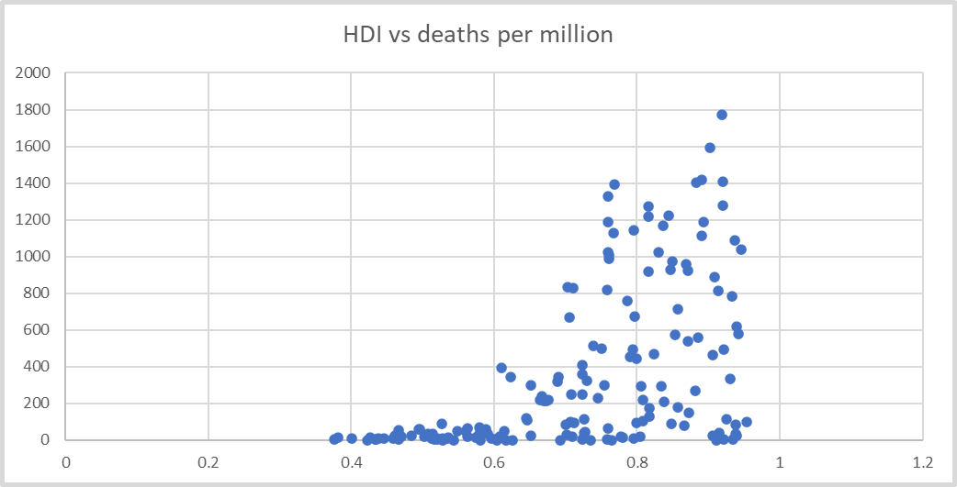
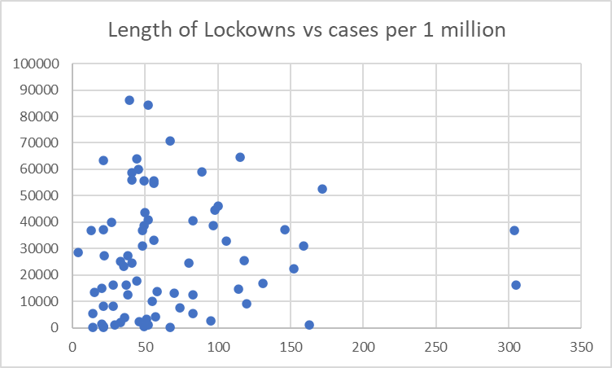
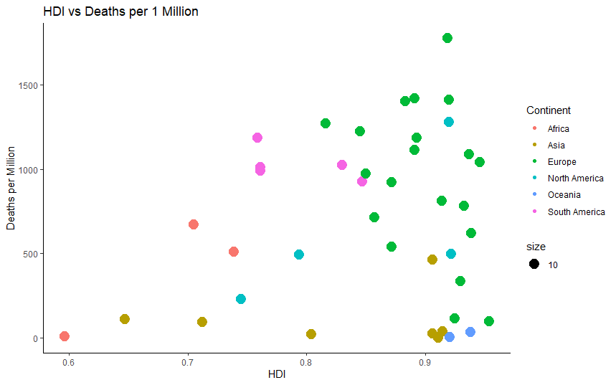
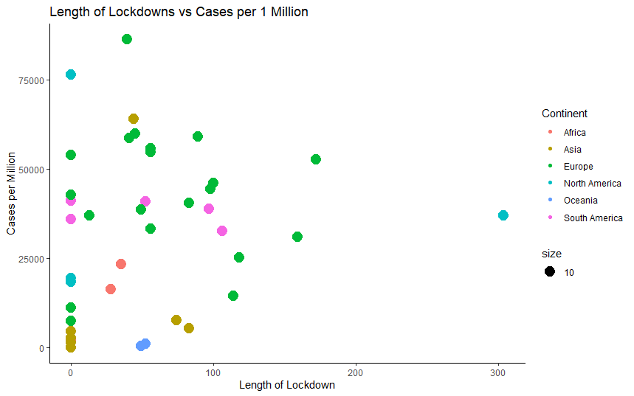
Scatter plots with All the Countries

Slide 8
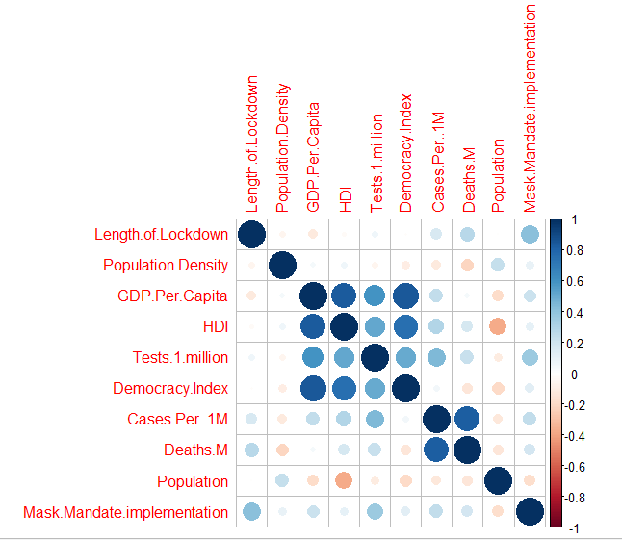

Correlation Plot in R
Explain the graph

